Slide 1
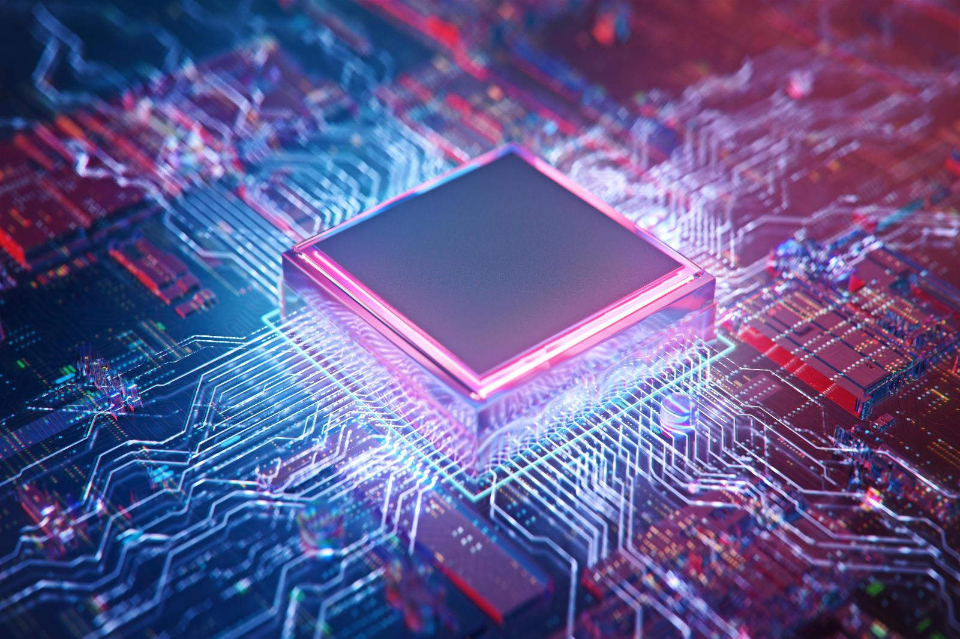
Computer Hardware

Slide 2
Types of Hardware
Input Devices
Output Devices
Input Devices Example: Keyboard, Mouse, Digital Pen, Microphone, Webcam
Output Devices Example: Monitor, Printer

Slide 3
Input Unit
It consist of various input devices, these devices provide their input to the CPU such as keystrokes of a keyboard, pixel information of a webcam.

Slide 4
Output Unit
It consist of various output devices, these devices take information from the CPU and provide it to the user.

Slide 5
Memory Unit
It is one of the fundamental component of a computer, without memory, computation is not possible.
Primary Memory: Every computer program must reside in Primary Memory before any execution can take place. This memory is the third fastest memory in a computer system after cache. Example: Random Access Memory
Secondary Memory: Primary Memory is very expensive and small in size, so we need cheap and large memory for long-term storage of our computation result which is why we use secondary memory such as Hard Disk, Solid State Drive.

Slide 6
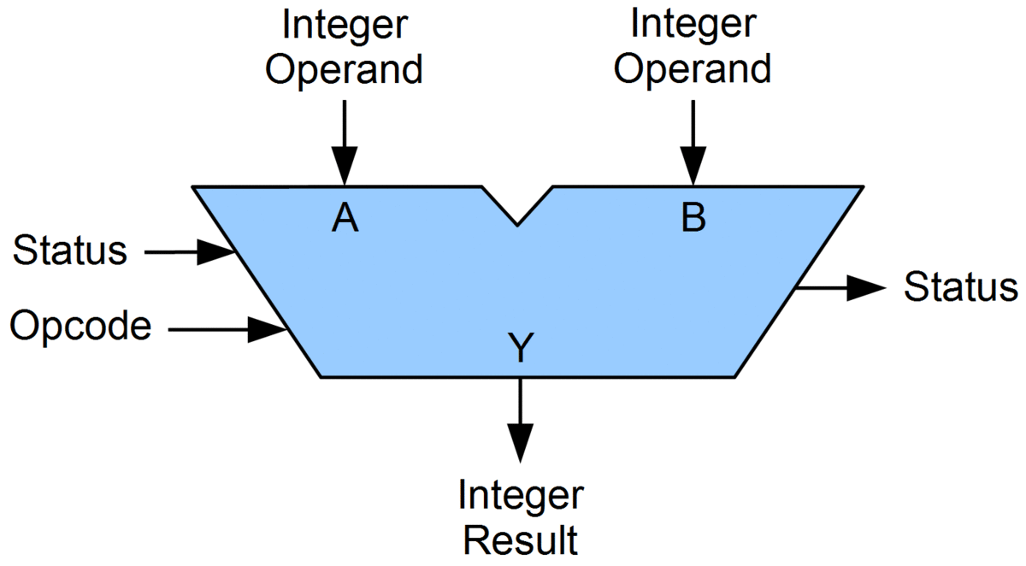
Arithmetic Logic Unit (ALU)
It is the heart of a computer, it is the unit which performs the actual computation, such as addition, multiplication, subtraction, division. The ALU resides inside the CPU.

Slide 7
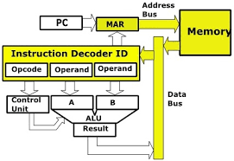
Central Processing Unit (CPU)
CPU consists of two main components, ALU and Control Unit, ALU is used for basic computation whereas Control Unit performs tasks such as fetching instruction/data, storing data.

Slide 8
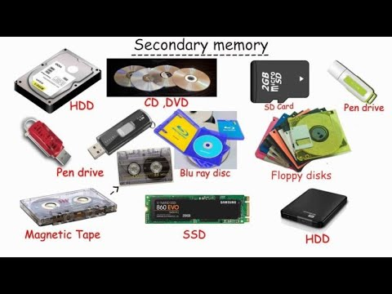
Secondary Storage
We need a long-term storage to store the result of our computations, it has to be cheap in price and also large in size. Secondary storage provides all these.
But one disadvantage of secondary storage is that whatever we store in secondary storage, must be brought into primary memory before any execution can take place.

